Slide 1
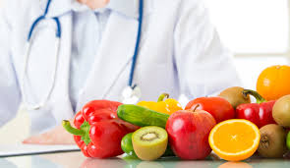
NUTRITION & HEALTH
Dr. Reshma Reghu
Lecturer,
Dept of Community Medicine

Slide 2
Defn..
Science of food and its relationship to health.
Good nutrition means maintaining a nutritional status that enable us to grow well and enjoy good health.
Community aspects of nutrition deals with 5 section
Dietary constituents
Nutritional Requirements
Assessment of Nutritional Status
Nutritional problems in public health
Nutritional programmes in India

Slide 9
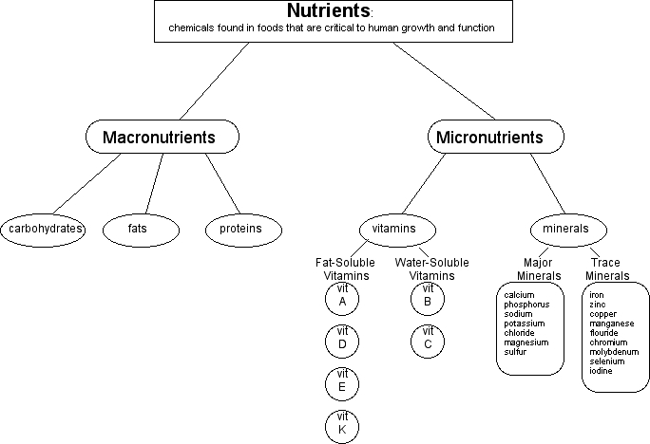

Slide 10
PROTEINS
which is of first importance
complex organic nitrogenous compounds
protein constitute 20 % of the body weight in an adult

Slide 12
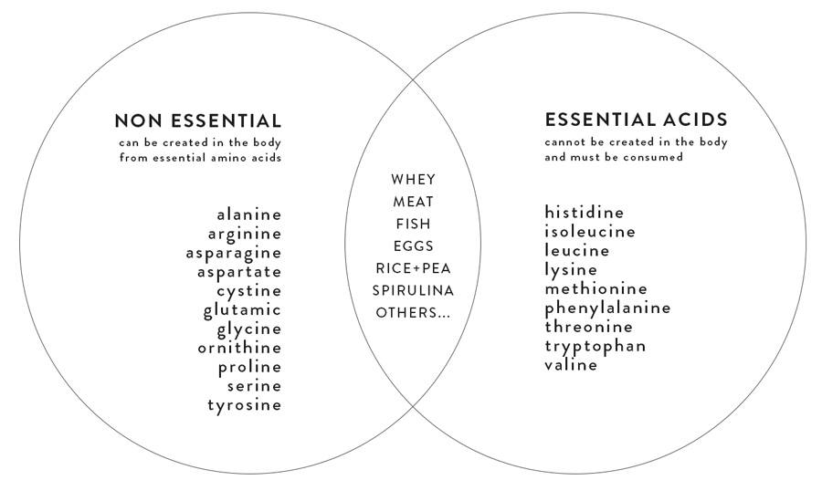

Slide 17
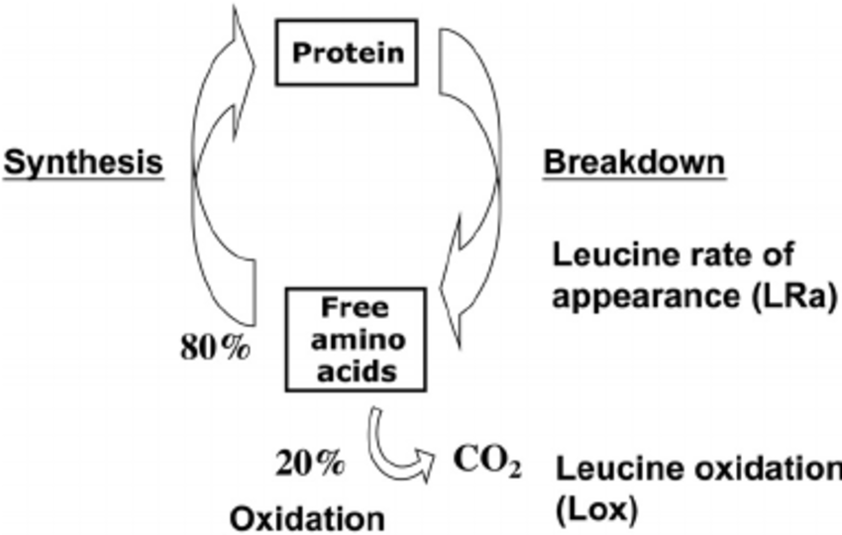

Slide 21
FATS
Fats are solid at 20*C
Oils in liquid state
Concentrated sources of energy
Human body can synthesis triglycerides & Cholesterol endogenously
Most of the human fat is in the form of adipose tissue
In normal human, adipose tissue constitutes between 10 t0 15 % of body weight
Accumulation of 1 kg of adipose tissue corresponds to 7,700 kcal of energy.

Slide 22
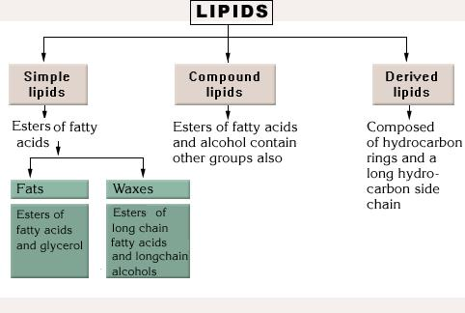

Slide 23
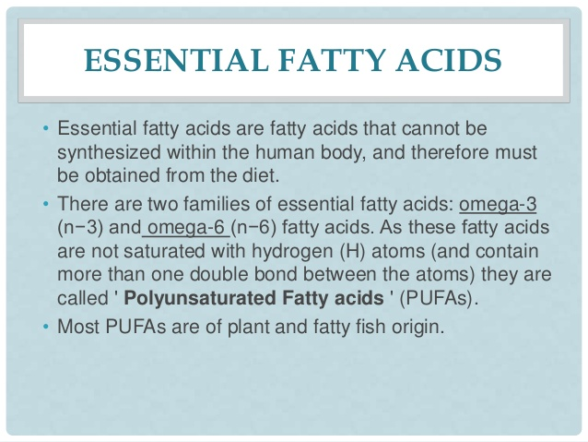

Slide 24
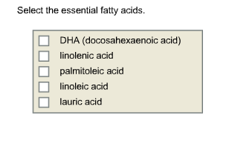

Slide 25
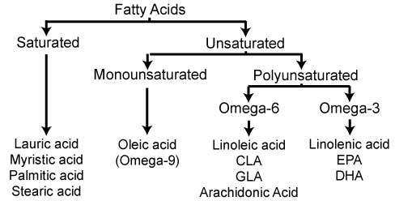

Slide 26
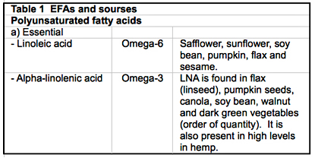

Slide 32
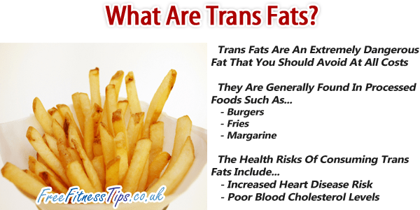

Slide 33
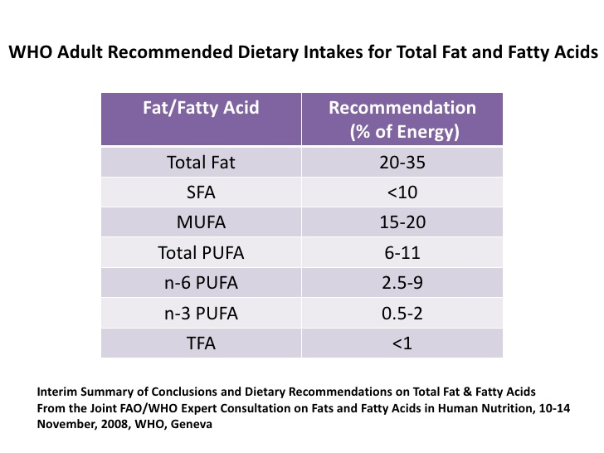

Slide 34
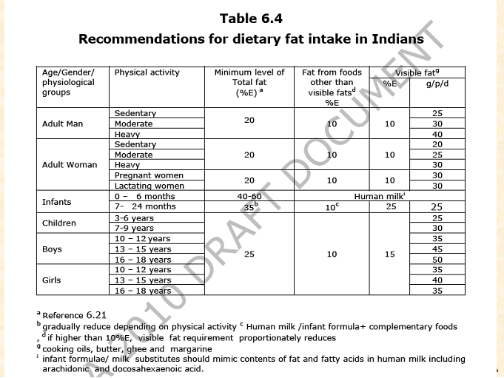

Slide 35
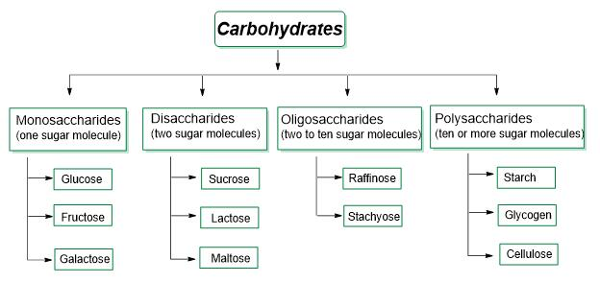

Slide 41
